Slide 1
Spanish I
Los Articulos (Definidos e indefinidos)
Definite and Indefinite Articles

Slide 2
Definite and Indefinite Articles
Noun and Article
Masculine and Feminine Noun
Singular and Plural Noun
Definite Article “THE”
Indefinite Article “A”, “An”, “The”

Slide 3
Noun and Article
In Spanish, all nouns belong to 2 gender categories:
_________________ or ________________
Masculine (masculino)
Feminine (feminino)

Slide 4
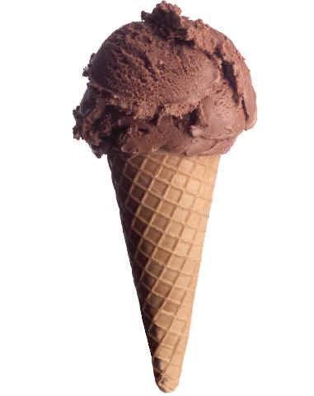
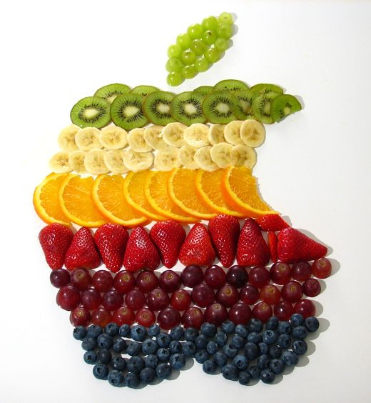
Masculine and Feminine Nouns
O
Masculine nouns USUALLY end in -___ →el helado
- Feminine nouns USUALLY end in -___. →la fruta
A

Slide 5
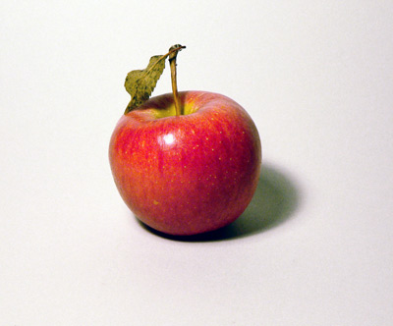
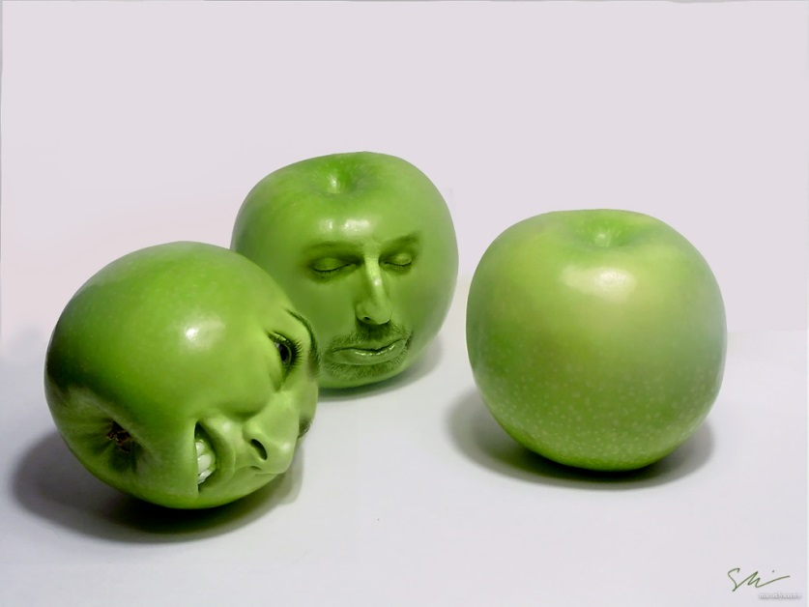
Singular and Plural Nouns
SINGULAR
____________.
the apple
the girl
the student
_____________
the apples
the girls
the students
PLURAL

Slide 6
Singular to Plural
If a noun ends in a _________ (a,e,i,o,u)→ ADD __S___ to make it plural.
chico → chicos
If a singular noun ends in a ____CONSONANT____ (r,l,n..) → ADD __ES___ to make it plural.
trabajador → trabajadores
VOWEL

Slide 7
Let’s Practice
chico → _______________
chica→ ________________
fruta → ________________
helado → ________________
persona → ________________
mu jer → ________________
hombre→ ________________
chicos
chicas
frutas
helados
personas
mujeres
hombres

Slide 8
Definite Article “THE”
When we want to say ___THE___ in Spanish, we use Definite Articles.
Definite Articles _________ according to the ___________ of the noun and according to the ___________ of the noun.
CHANGE
gender
Number

Slide 9
Definite Articles: The
 | MASCULINE | FEMININE
SINGULAR
PLURAL
EL
LA
LOS
LAS

Slide 10
Let’s Practice
la galleta→ ________________
el refresco → ________________
el estudiante →________________
la estudiante →________________
la pizza→ ________________
las galletas
los refrescos
los estudiantes
las estudiantes
las pizzas

Slide 11
Indefinite Article “A”/ “An”/”Some”
“a”
“an”
When we want to say ____, ____, or________ in Spanish, we use Indefinite Articles.
Indefinite Articles also ______________ according to the ___________ of the noun and according to __________ of the noun.
“some”
CHANGE
gender
Number

Slide 12
Indefinite Articles: a/an/some
 | MASCULINE | FEMININE
SINGULAR
PLURAL
UN
UNA
UNOS
UNAS

Slide 13
Let’s Practice
un amigo→ ________________
una amiga → ________________
un deporte → ________________
un sombrero → ________________
una pizza→ ________________
una fiesta → ________________
unos amigos
unas amigas
unos deportes
unos sombreros
unas pizzas
unas fiestas

Slide 14
Summary
Noun and Article
Masculine and Feminine Noun
Singular and Plural Noun
Definite Article “THE”
Indefinite Article “A”, “An”, “The”

